Slide 1

SafetyNet
A rapid response disaster relief system

Slide 2
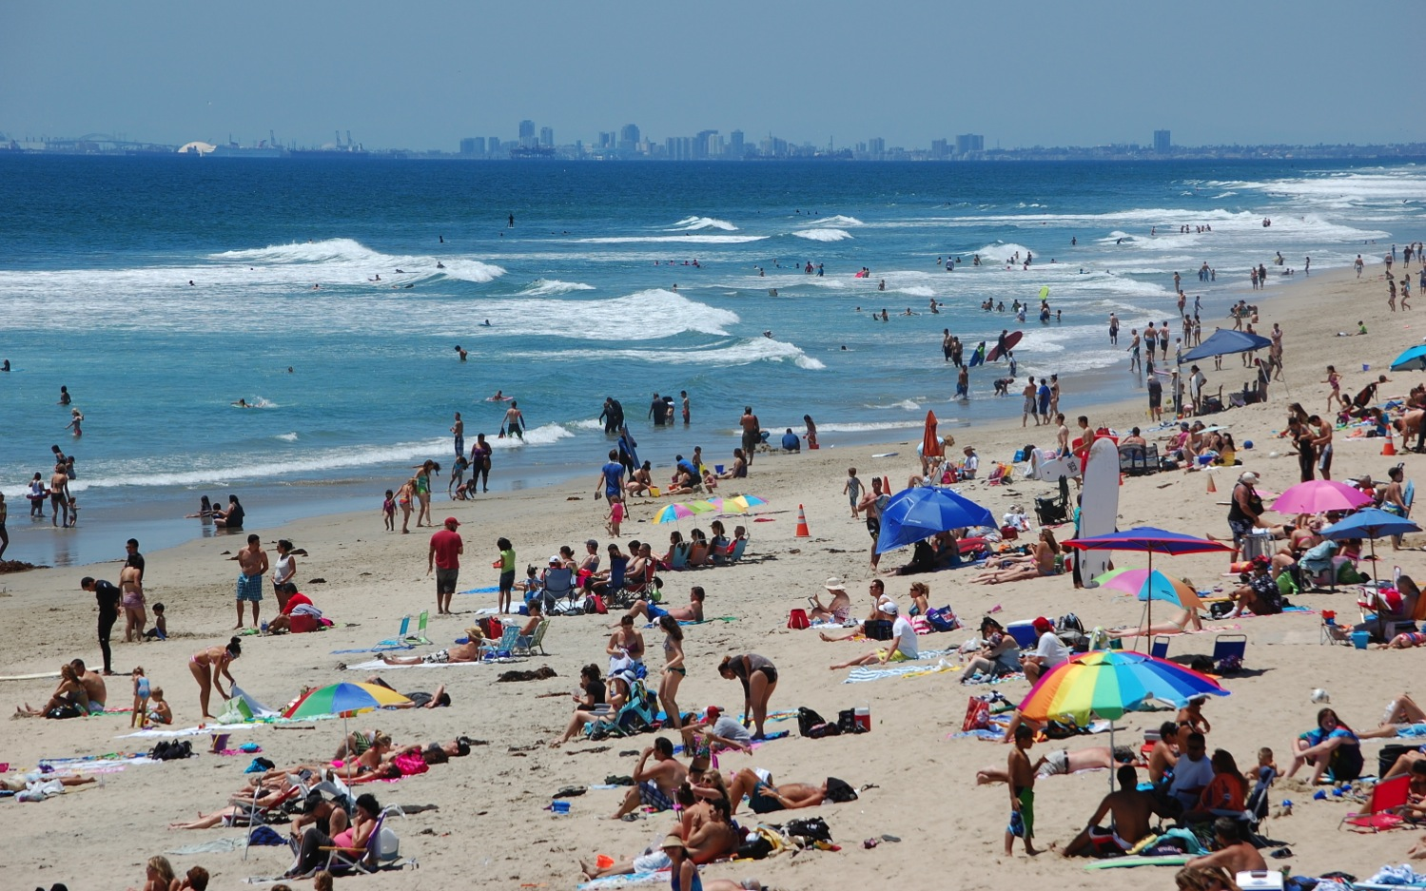

Slide 3
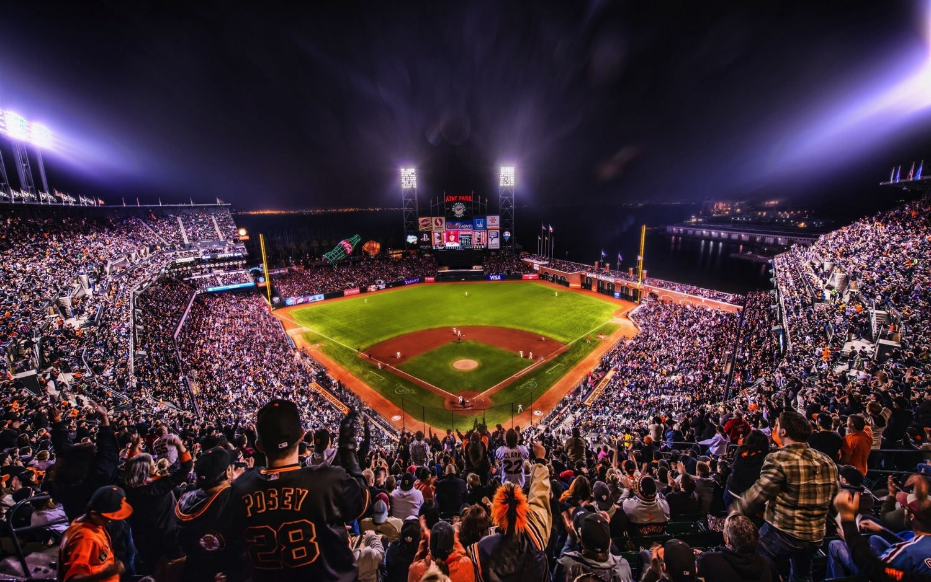

Slide 4
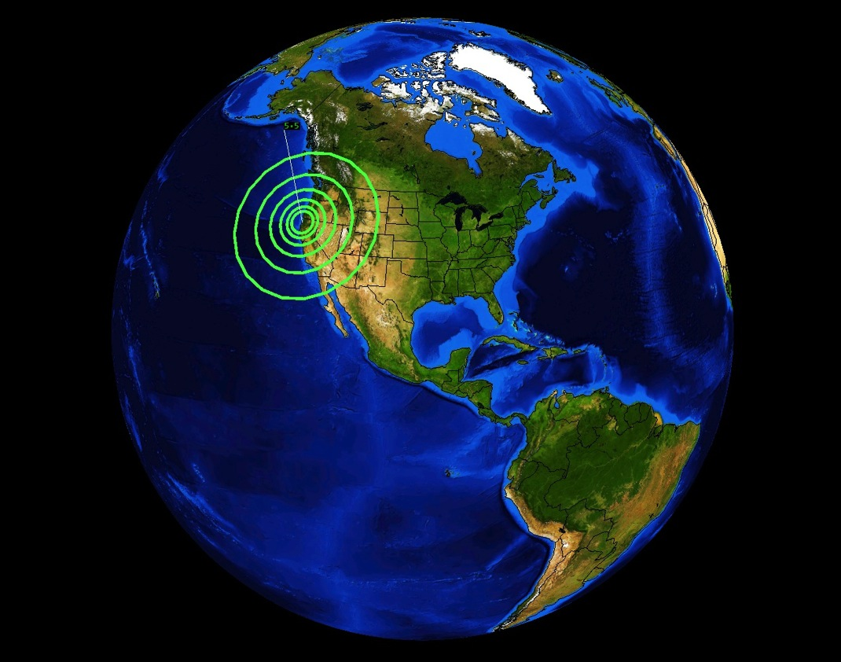

Slide 5
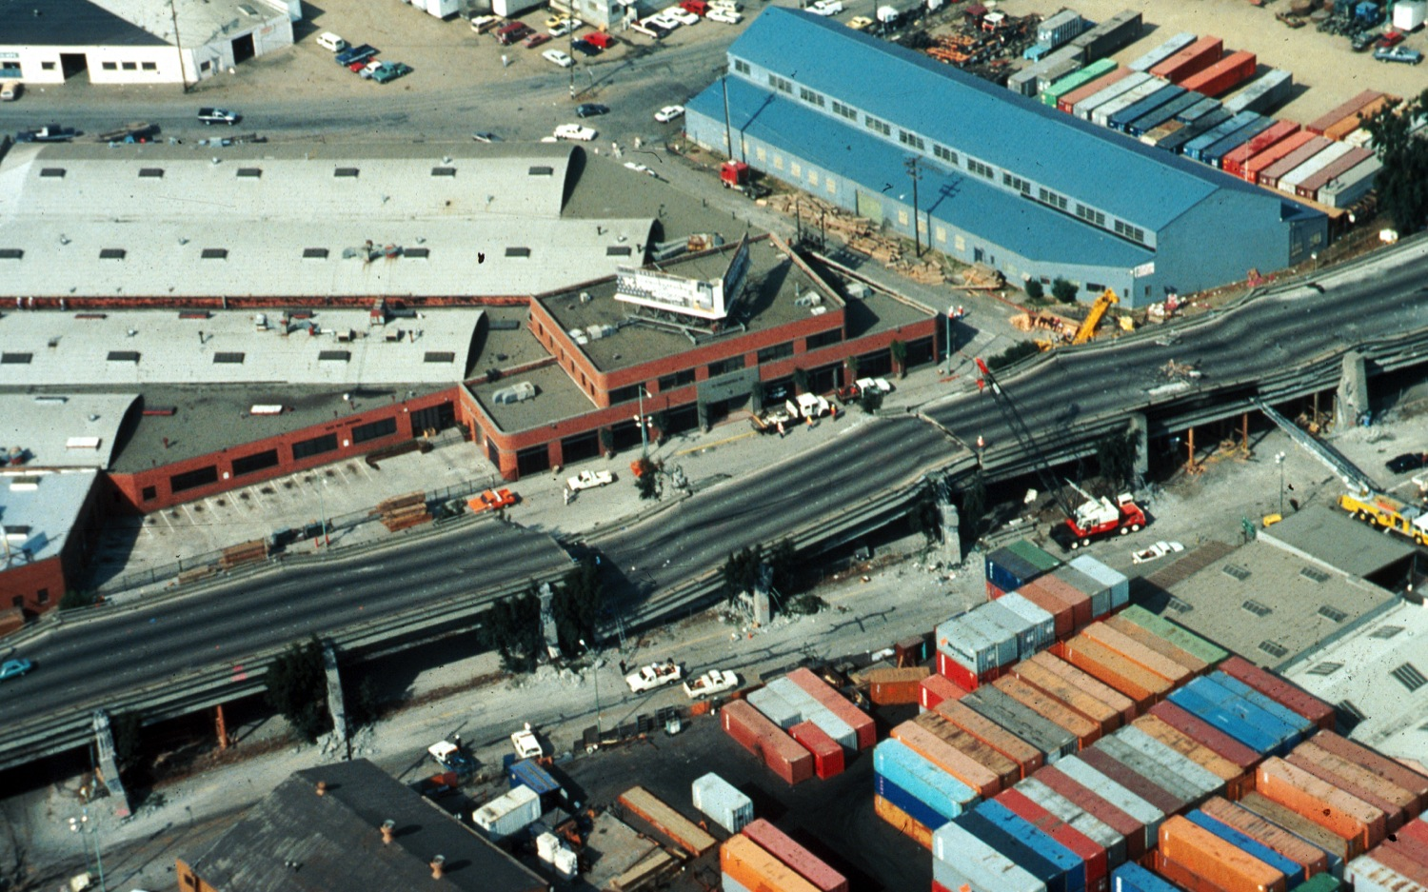

Slide 6
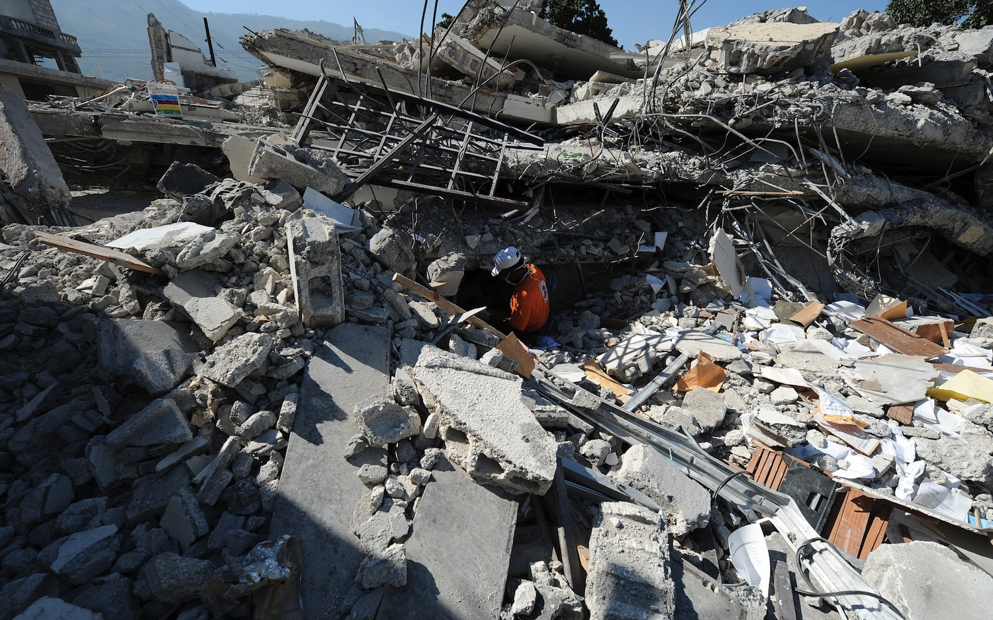

Slide 7
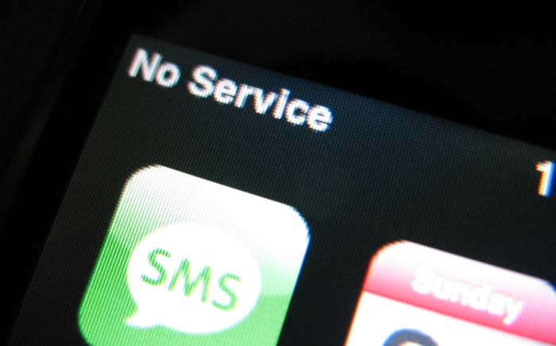

Slide 8
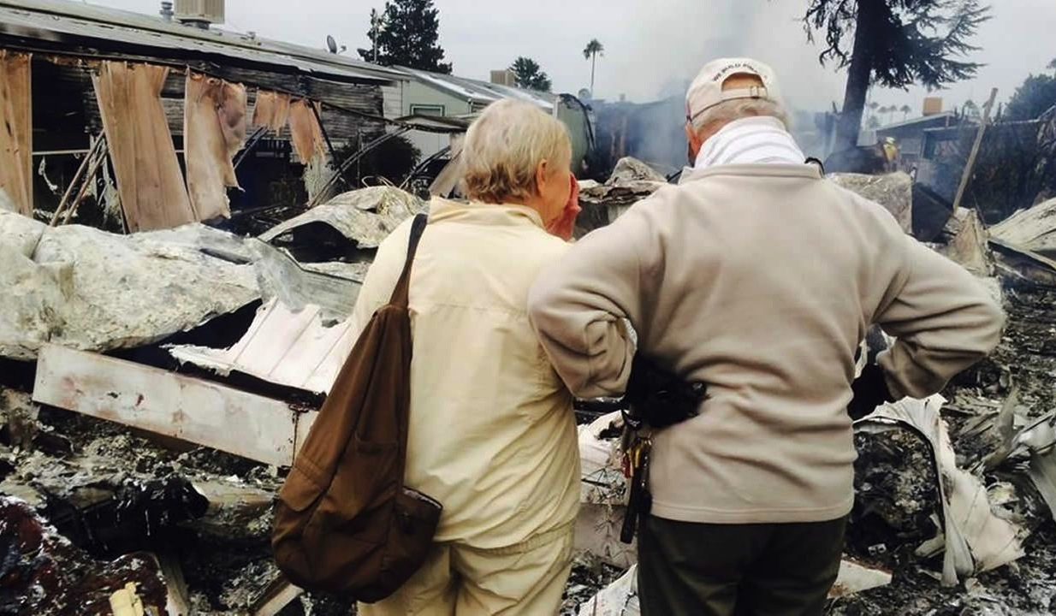
What do I do now?

Slide 9
SafetyNet
A rapid response disaster relief system

Slide 10




Slide 11


Safe Zone
Disaster Zone

Slide 12





Safe Zone
Disaster Zone

Slide 13
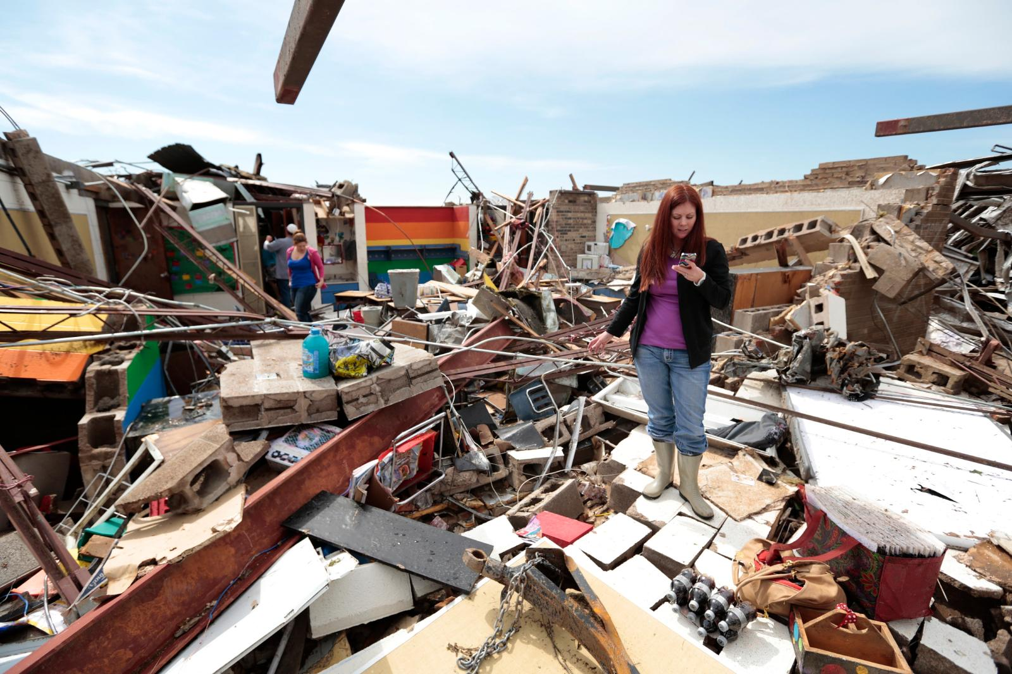

Slide 14
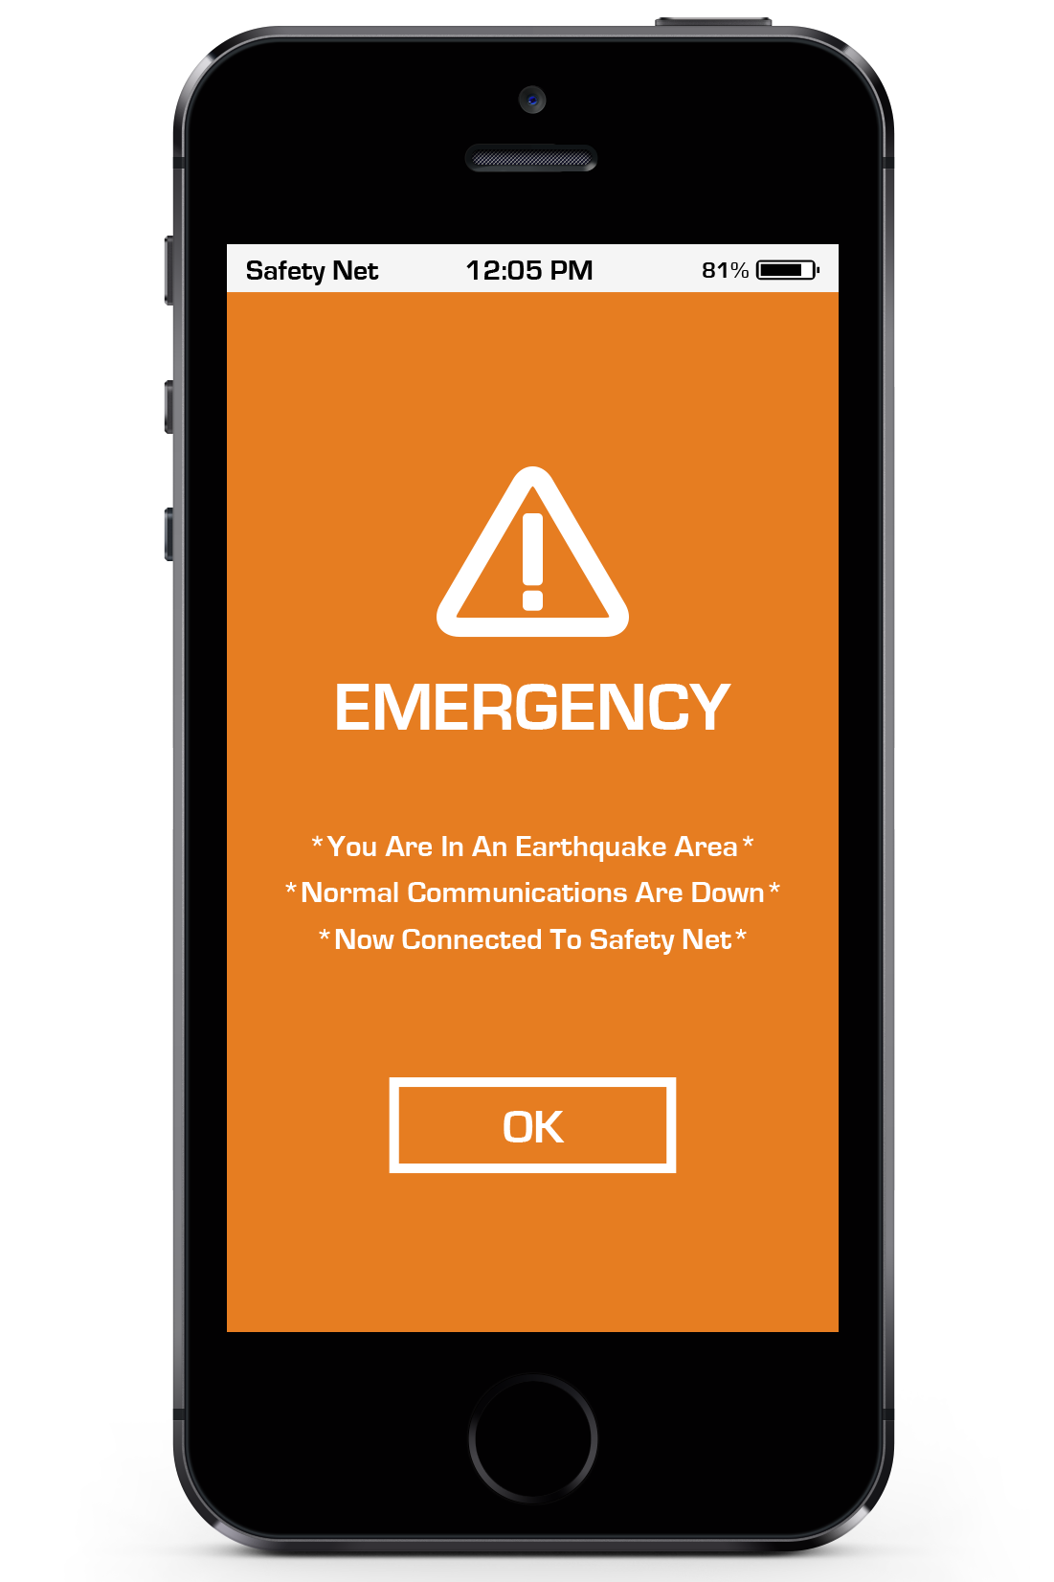
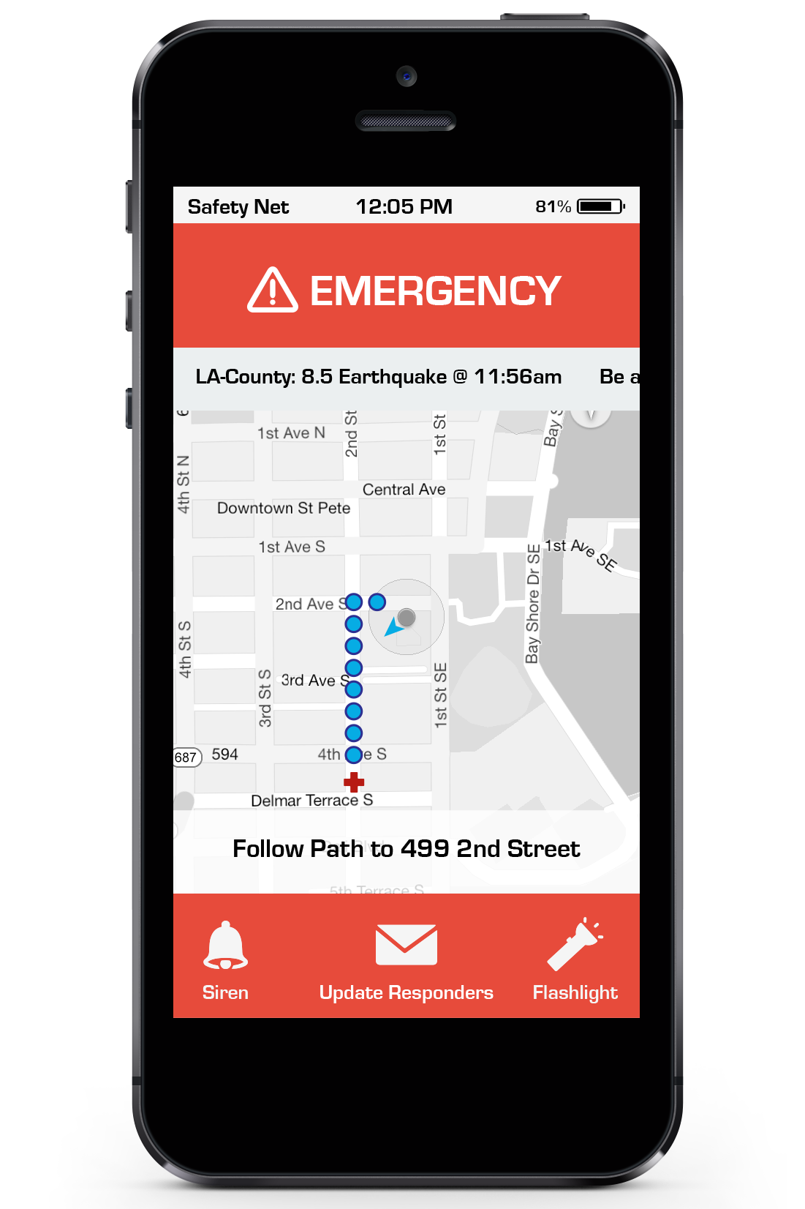
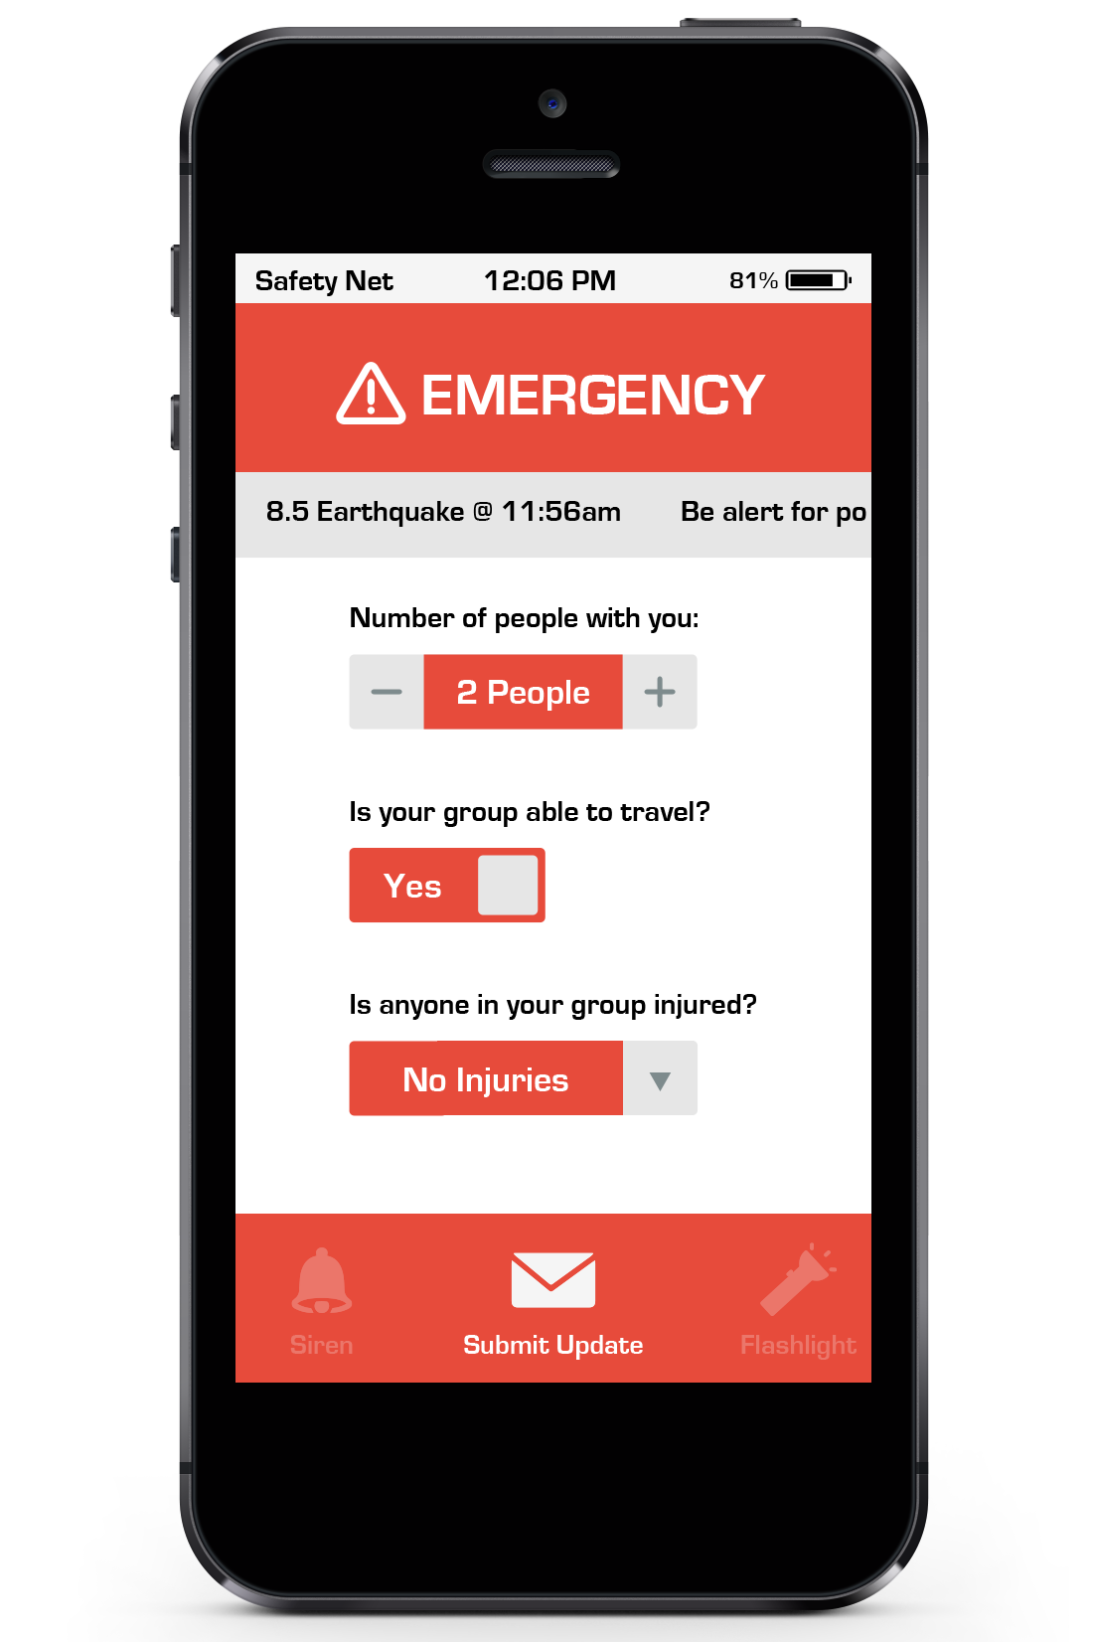

Slide 15
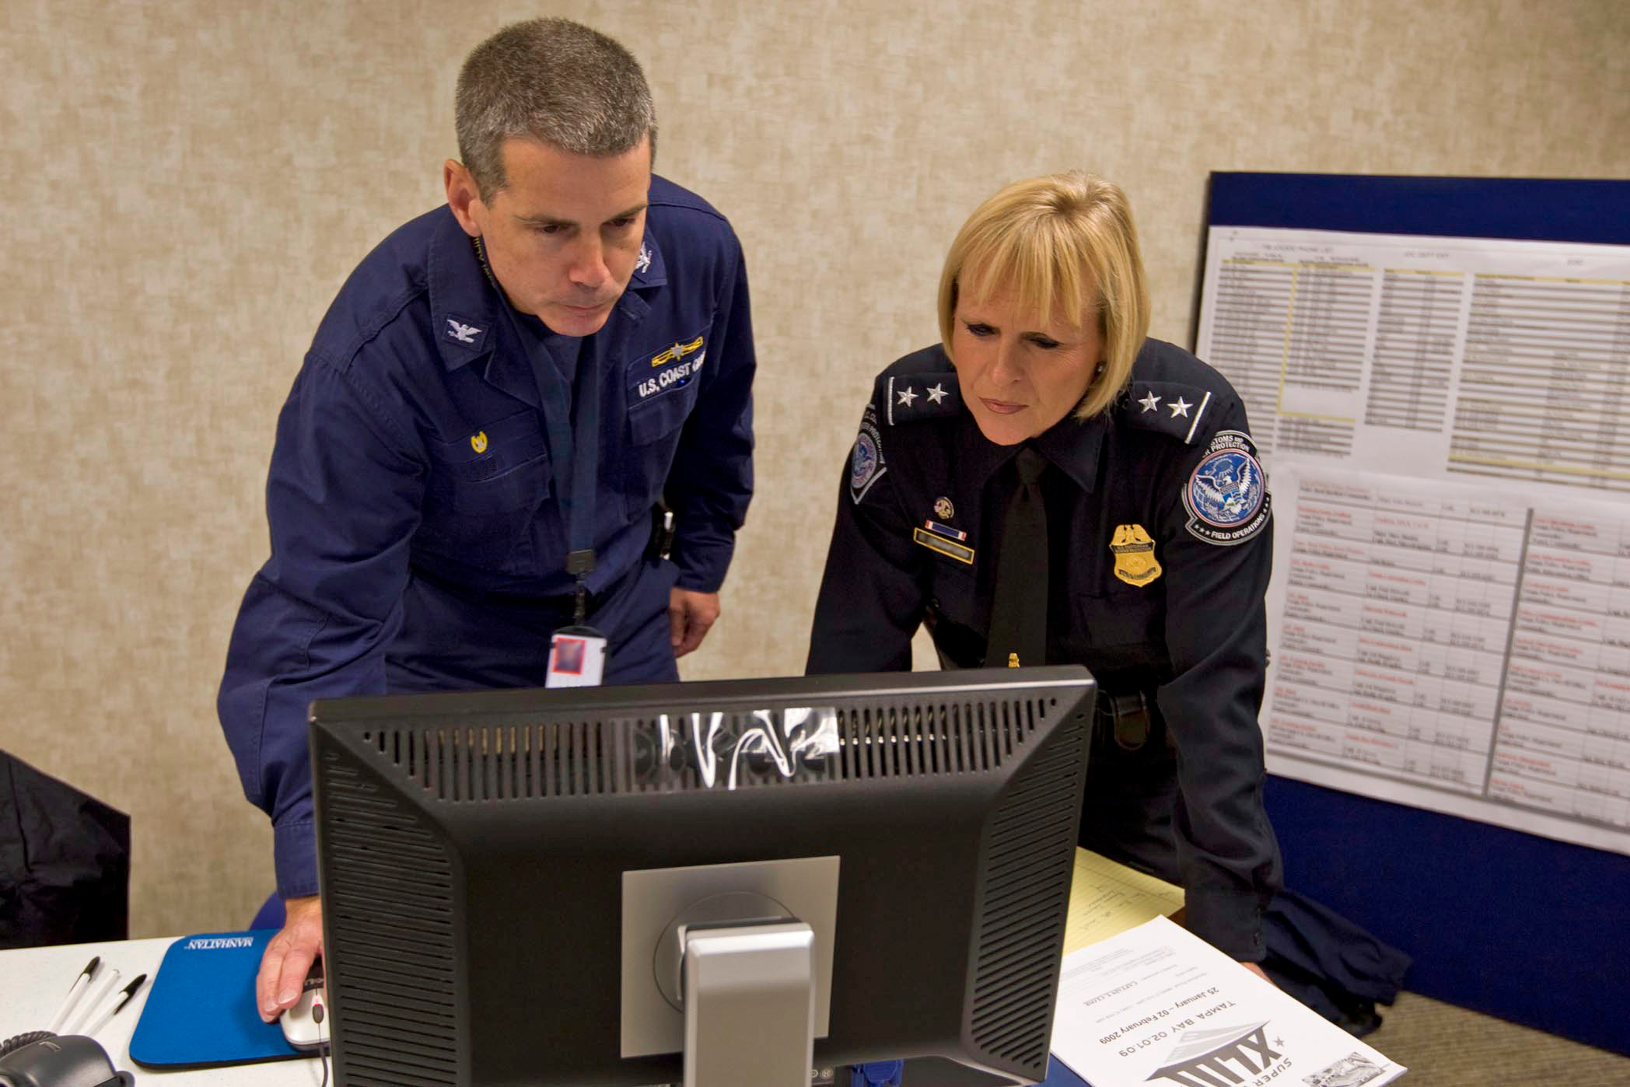

Slide 16
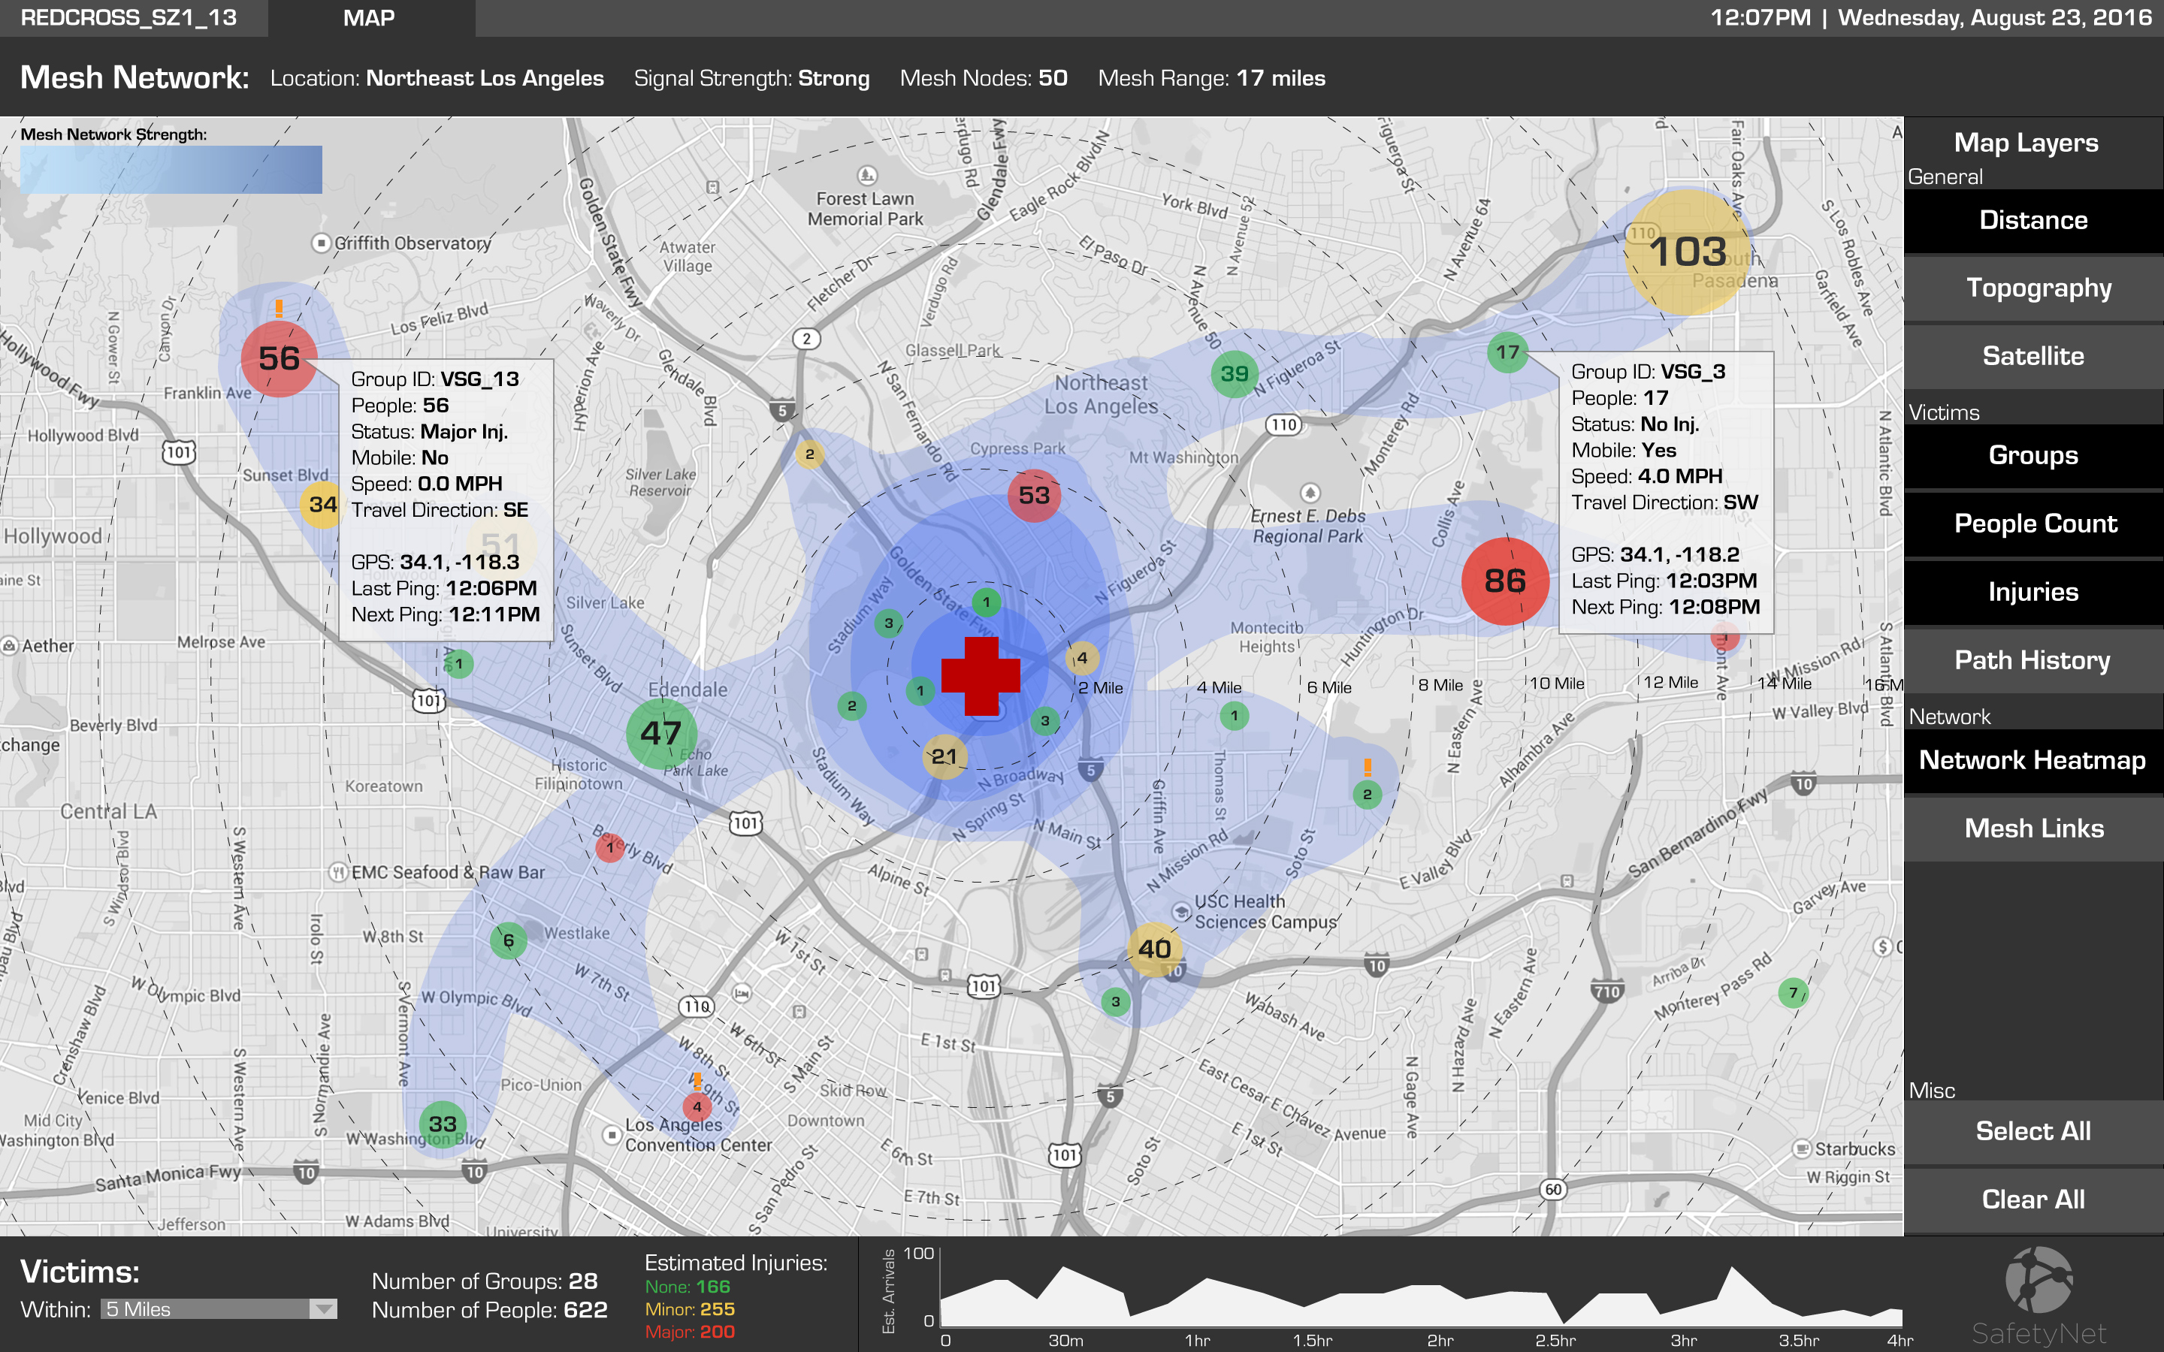

Slide 17
Demo

Slide 18
The Process

Slide 19
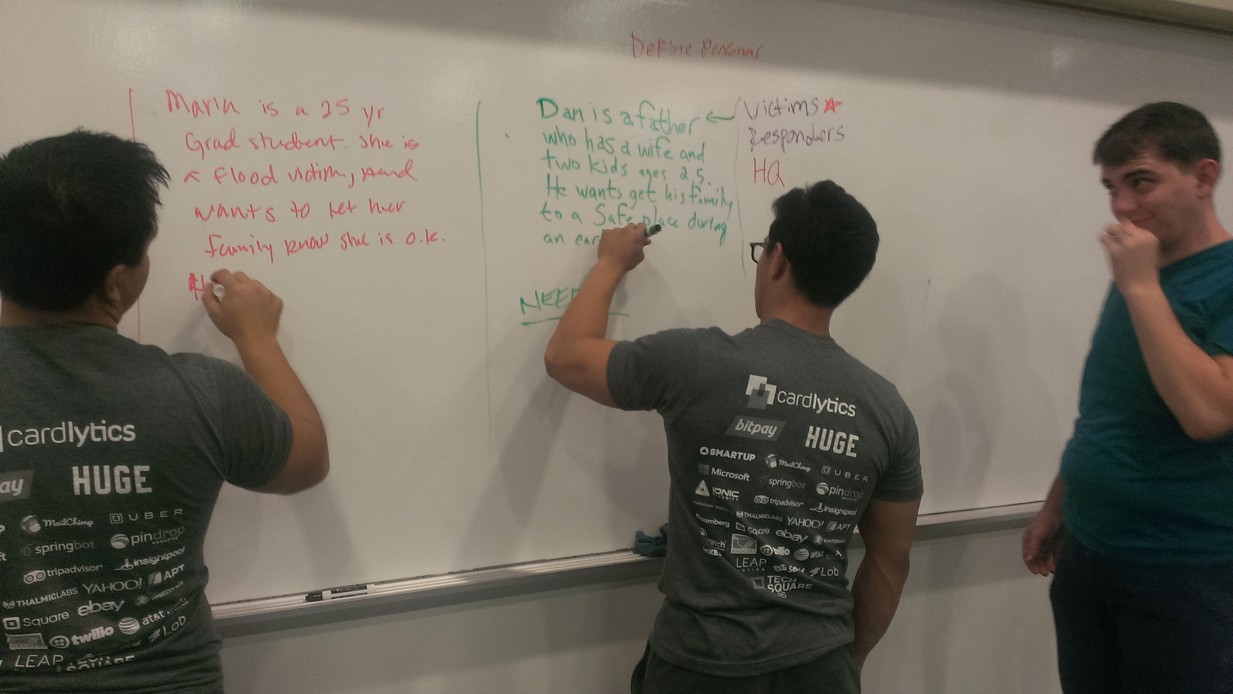
Persona Creation

Slide 20
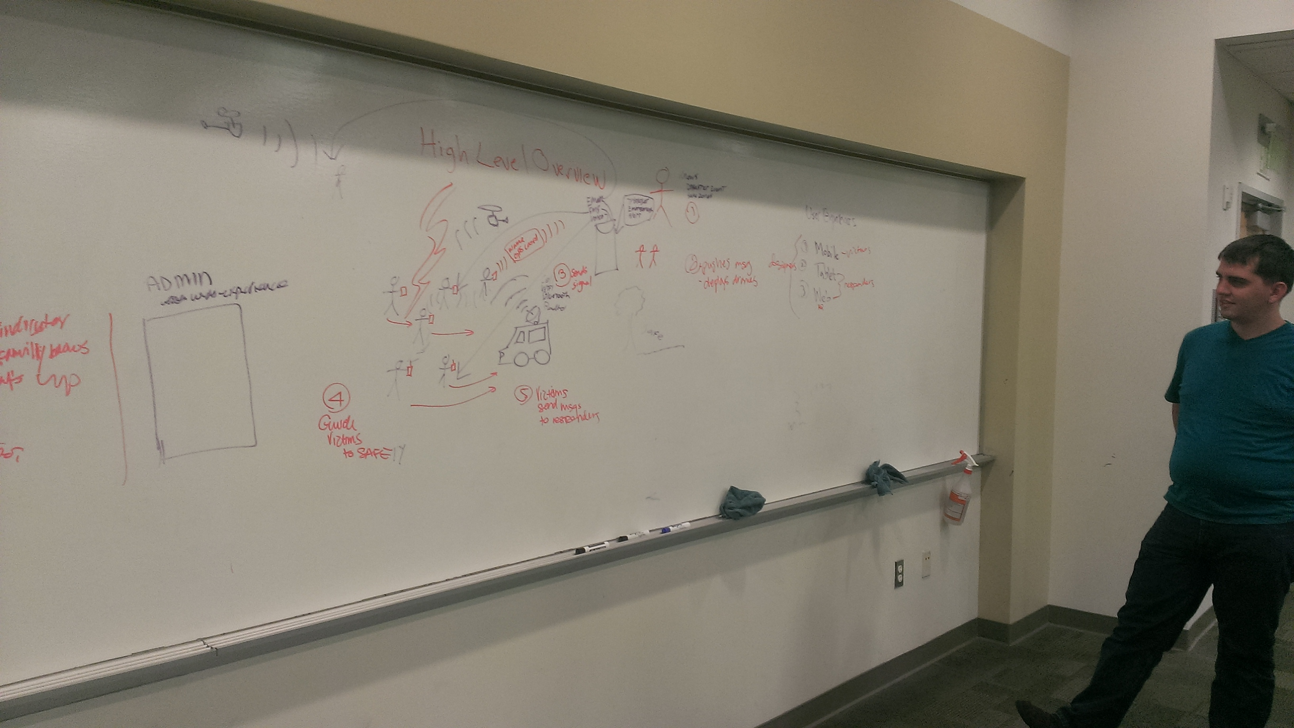
High-Level Conceptualization

Slide 21
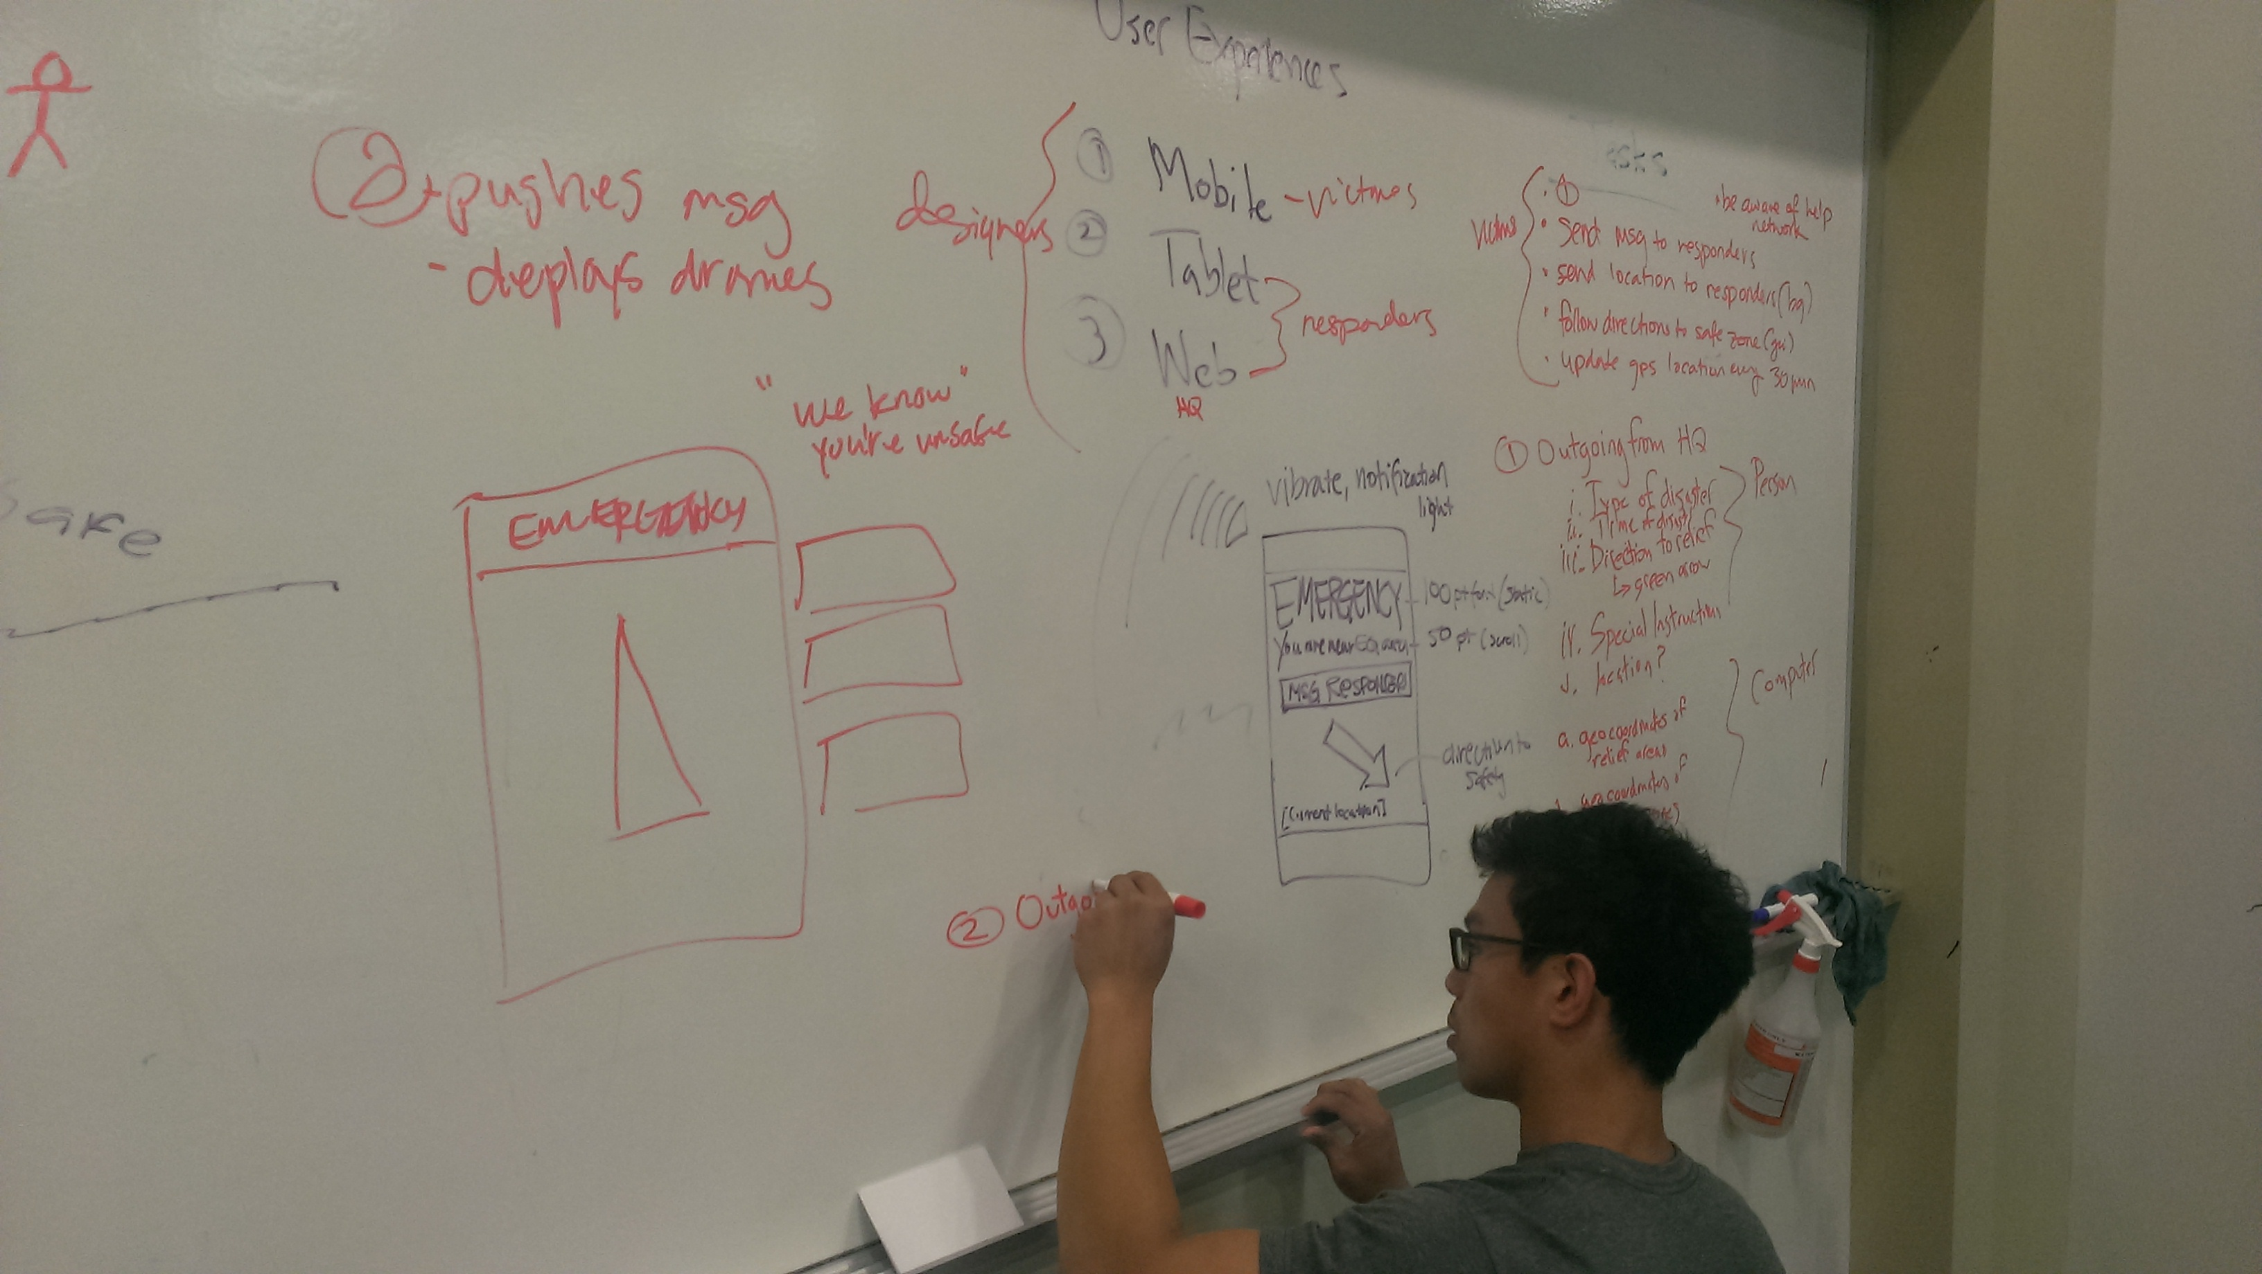
Low-Fidelity Mobile Prototyping

Slide 22
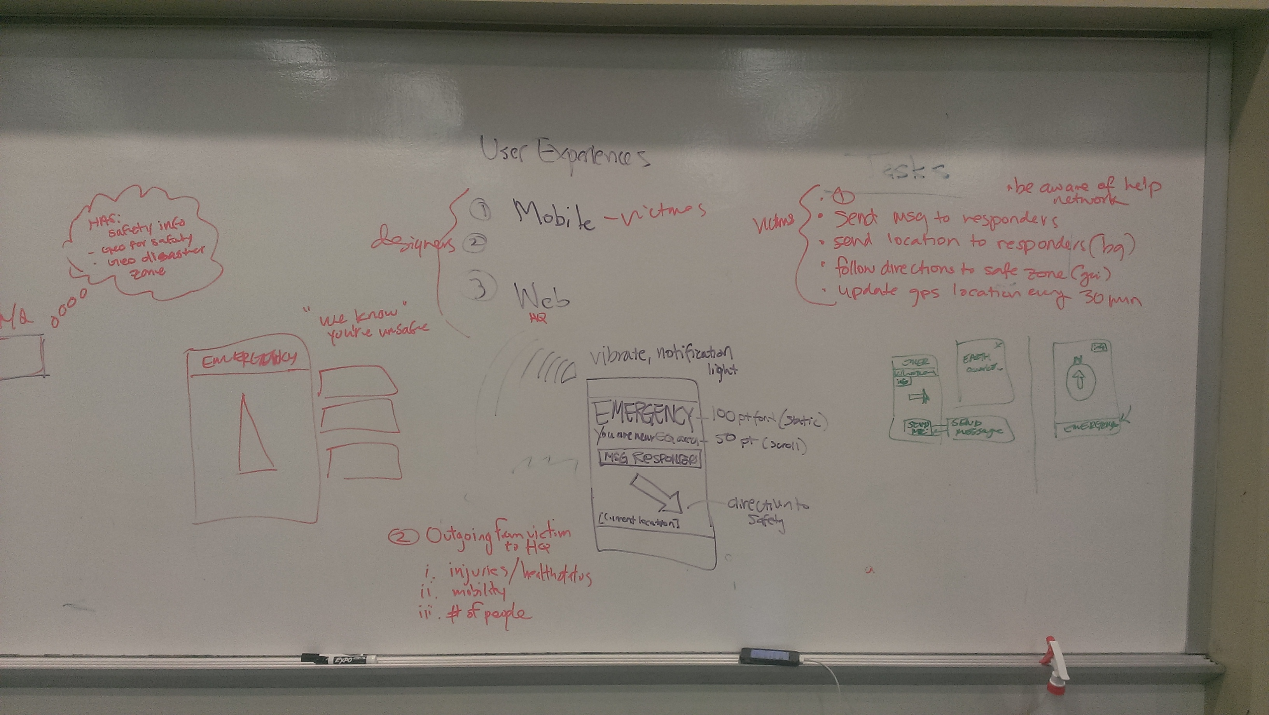
Low-Fidelity Mobile Prototyping

Slide 23
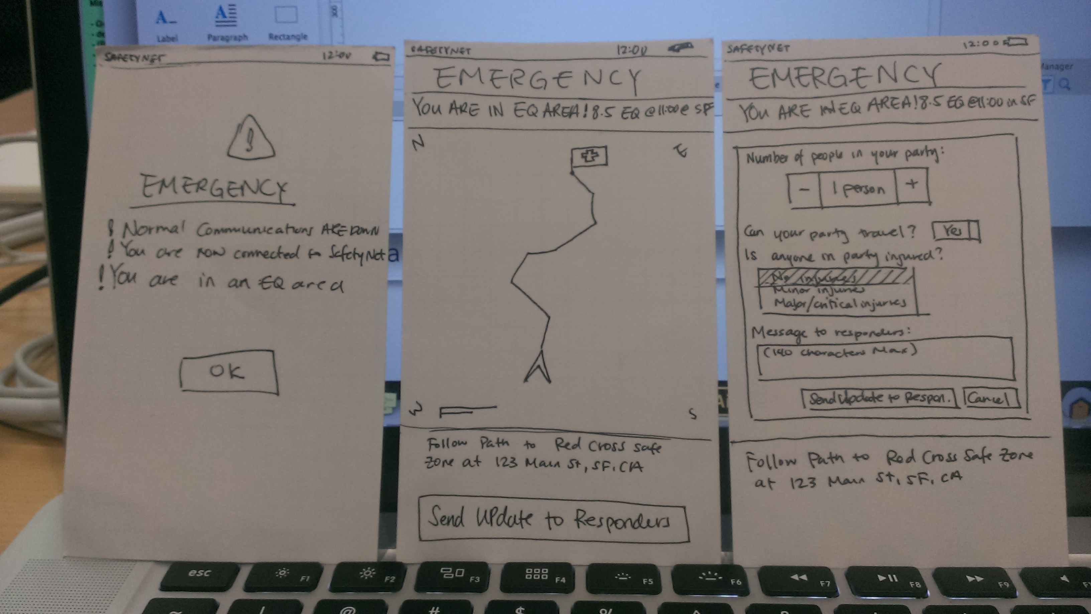
Low-Fidelity Mobile Paper Prototyping

Slide 24
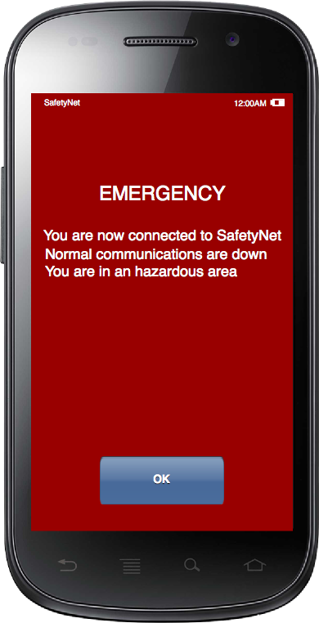
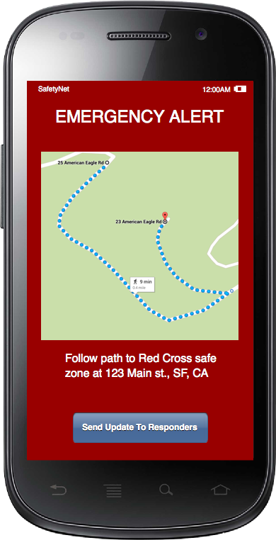
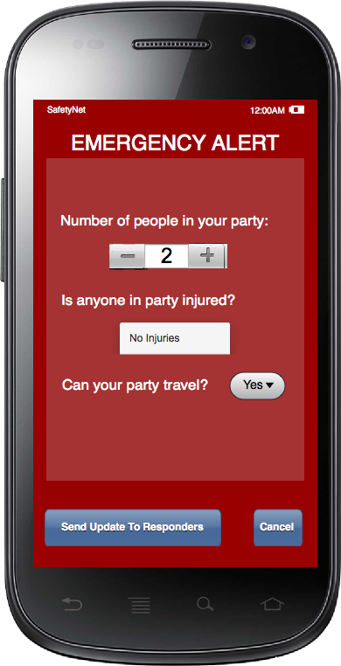
Medium-Fidelity Interactive Mobile Prototyping

Slide 25
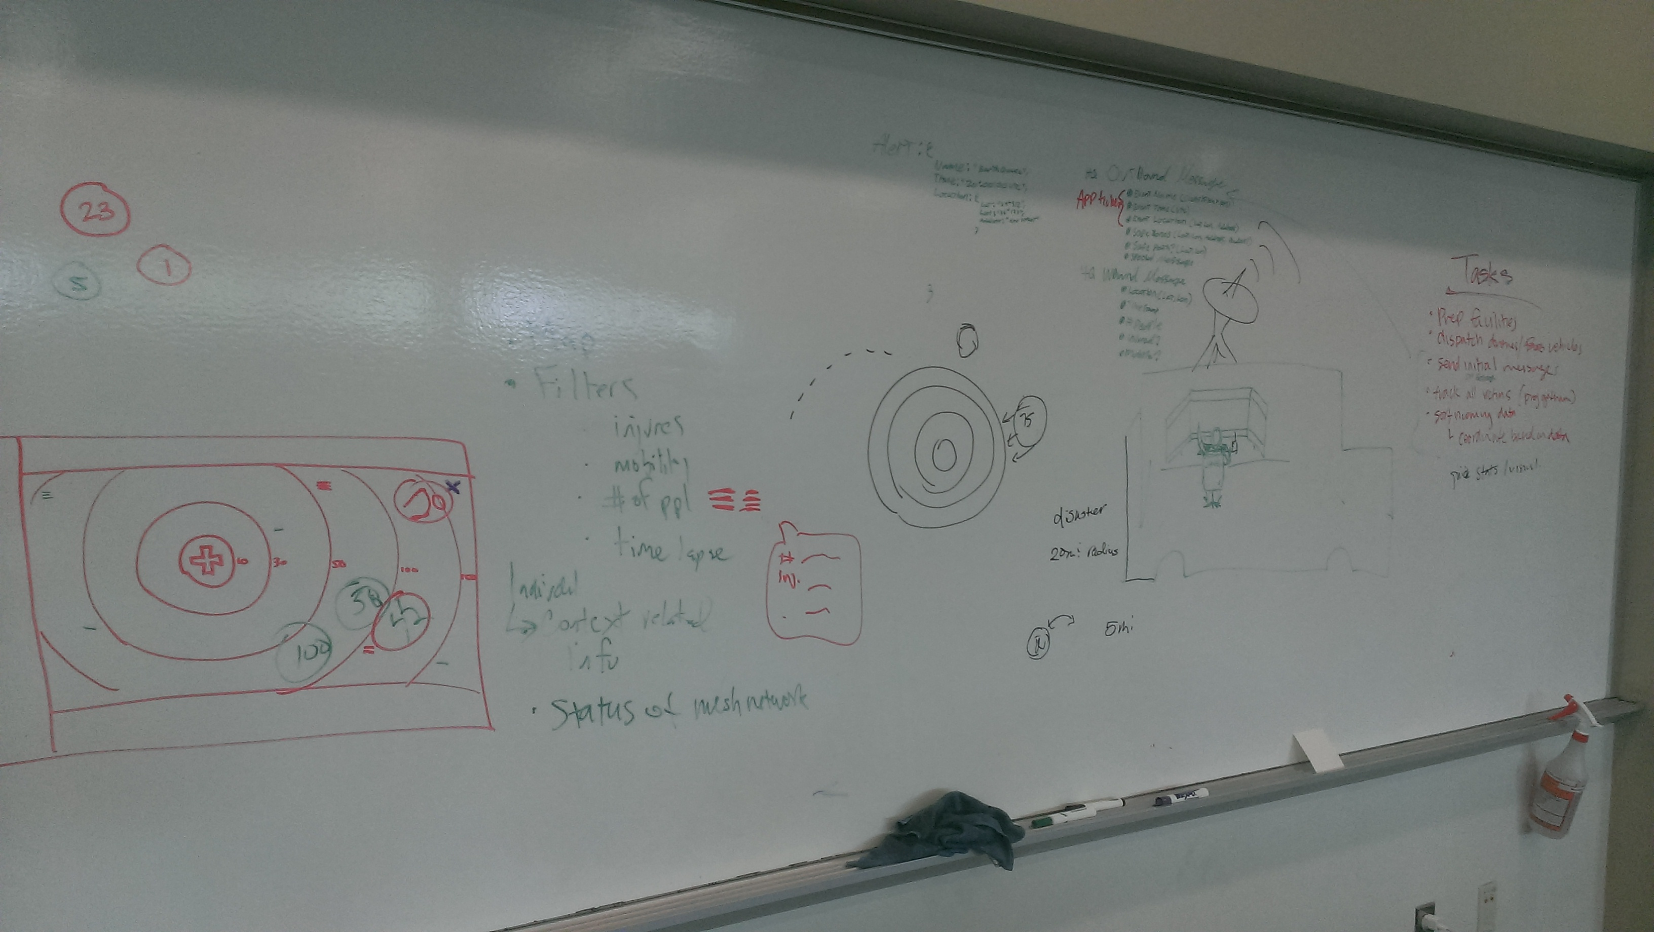
Low-Fidelity Web Prototyping

Slide 26
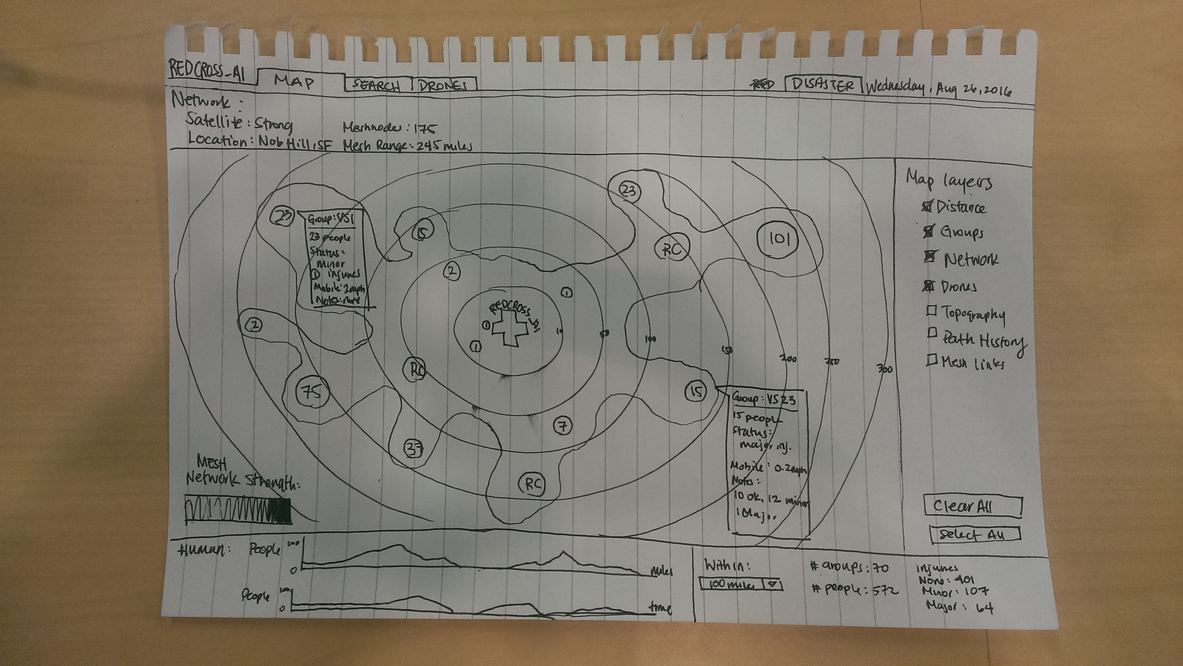
Low-Fidelity Web Paper Prototyping

Slide 27
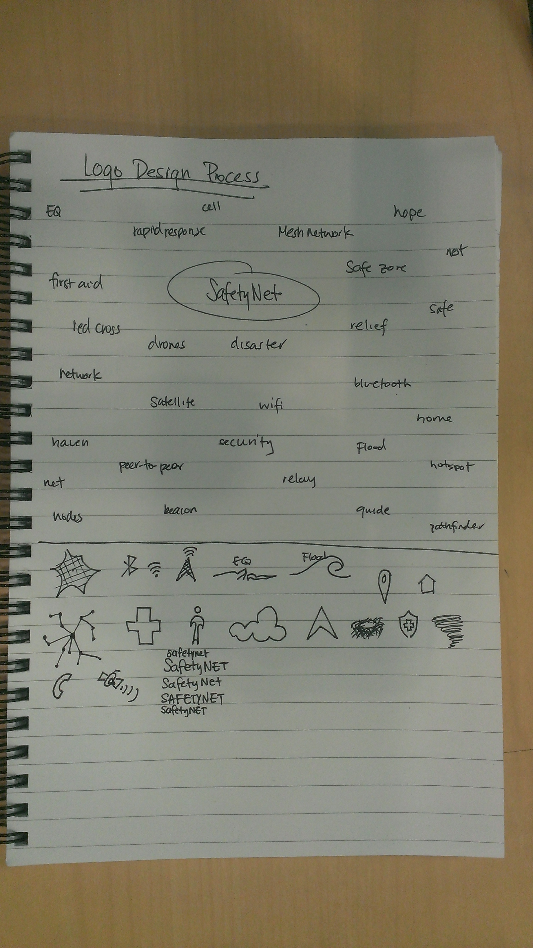
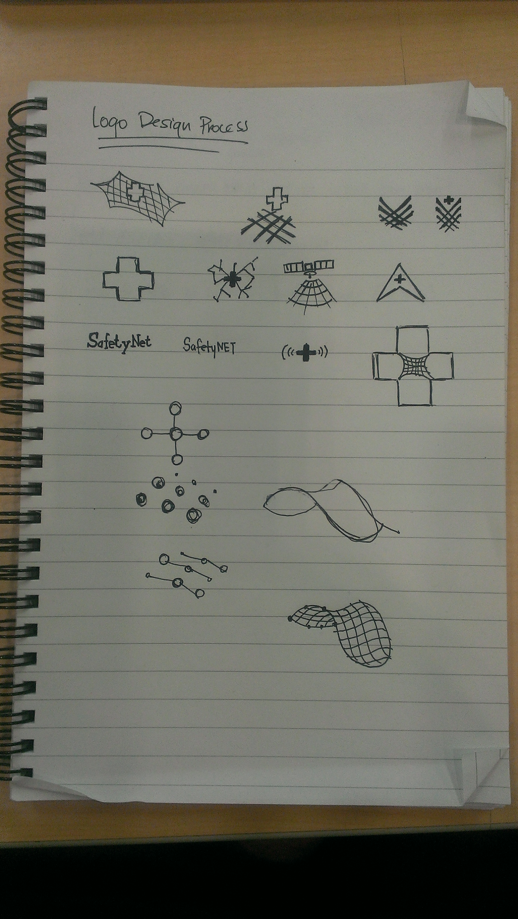
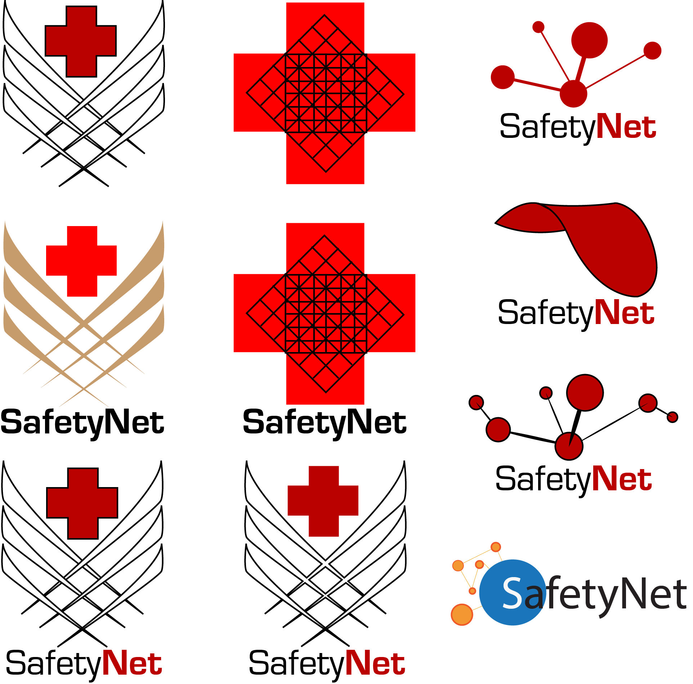

Logo Prototyping

Slide 28
Thank You

